Slide 1
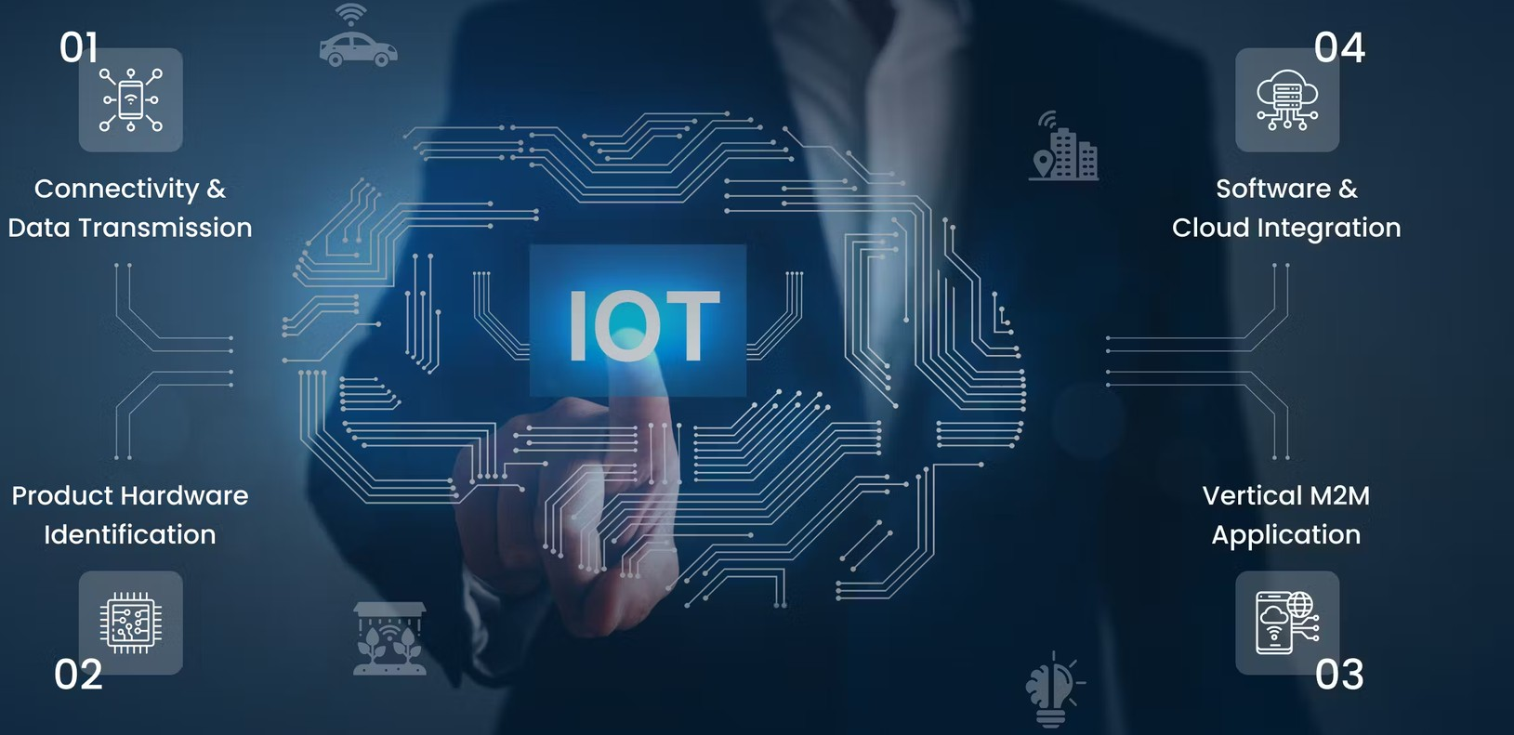
Serverless Iot Data Processing
Submitted by S.Meshach Immanual S.Naveen
G V. Ramanan A.Ragul N.Ravichandran

Slide 2
Data Ingestion Function
const Cloudant = require('@cloudant/cloudant');
function main(params) {
const { deviceId, data } = params;
// Store IoT data in a database (e.g., Cloudant)
const cloudant = new Cloudant({ url: 'YOUR_CLOUDANT_URL', plugins: { iamauth: { iamApiKey: 'YOUR_API_KEY' } } });
const db = cloudant.db.use('iot_data_db');
// Store IoT data in the database
return db.insert({ deviceId, data, timestamp: new Date() })
.then(() => {
return { message: 'Data stored successfully.' };
})
.catch(error => {
console.error('Error storing data:', error);
throw error;
});
}

Slide 3
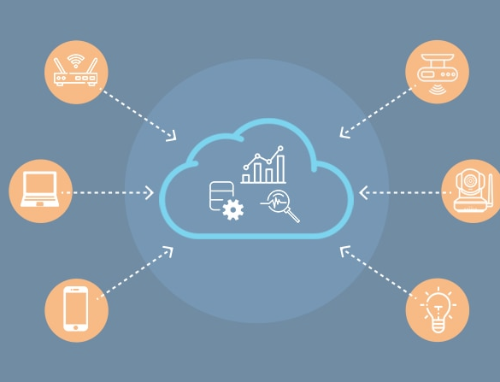

Abstract of Data processing
Serverless IoT data processing leverages cloud resources to analyze and manage data from Internet of Things (IoT) devices without the need for dedicated servers. This approach enhances scalability, reduces operational overhead, and allows real-time data processing.
It supports applications like smart home systems,
sensing.
industrial monitoring, and environmental
Serverless computing eliminates the burden of server
management and ensures efficient, cost-effective IoT data processing in the cloud.

Slide 4
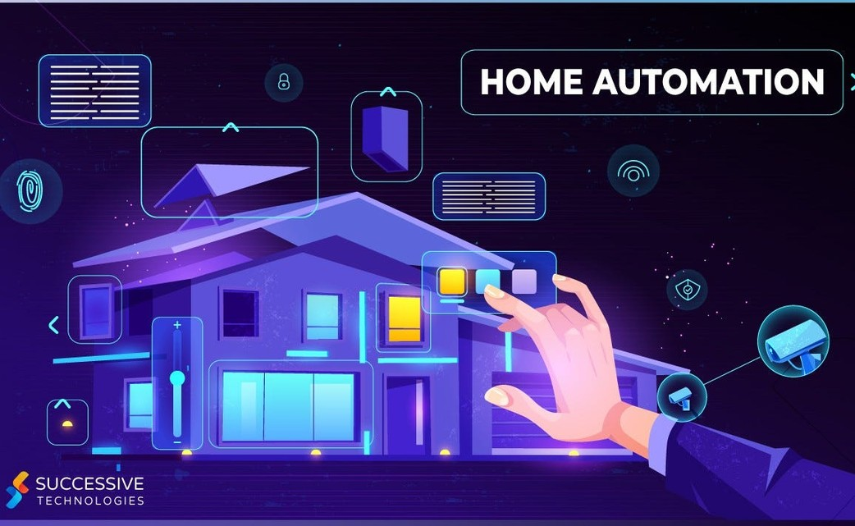
Problem Statement of Serverless Iot
Transforming your home into a smart living space using IBM Cloud Functions for IoT data processing.
Collect data from smart devices like thermostats, motion sensors, and cameras, and process it in real- time.
Automate routines for energy efficiency and home security. Store and analyze data in IBM Cloud Object Storage to gain valuable insights into your smart home.

Slide 5

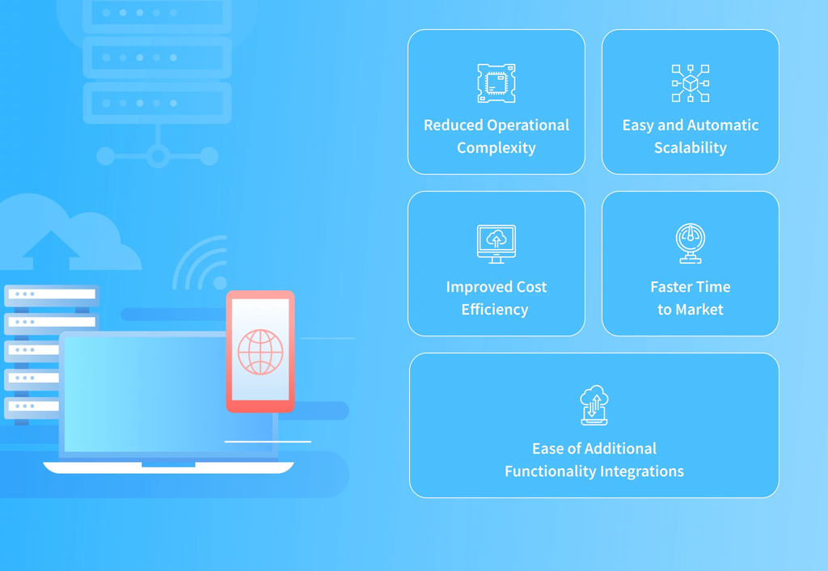
Existing Concept of Serverless Iot
Event-Driven: IoT devices trigger automatic actions with serverless functions.
Scalable & Cost-Effective: Serverless reduces costs and dynamically scales resources.
Cloud Data: Secure cloud storage for remote access and control.
Integration & Automation: Streamlined tasks, like thermostat adjustments, for convenience and efficiency.

Slide 6
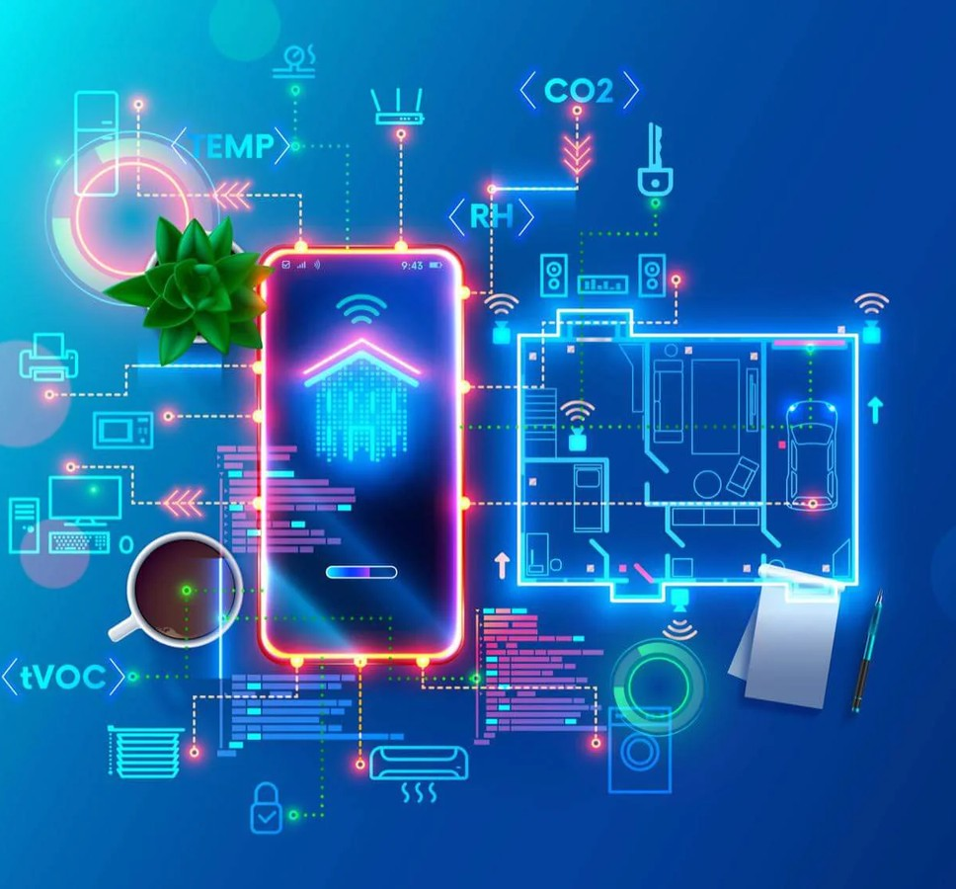
Problem and Design
The project is transform a normal home into a smart living space using IBM Cloud Functions for IoT data processing.
The goal is to collect data from various smart devices, process in real-time and automate routines for energy efficiency and home security.
It involves designing the smart home setup, implementing data collection and processing and leveraging IBM Cloud for storage and analysis.

Slide 7
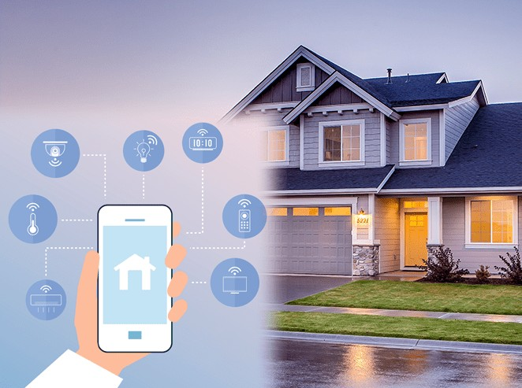
Design Thinking
Data Integration: Identify and integrate smart devices such as thermostats, motion sensors, and cameras into the smart home ecosystem.
Data Collection: Set up data collection from these devices, utilizing IoT protocols.
Real-time Processing: Implement real-time data processing using IBM Cloud Functions.
Automation: Develop automated routines for energy efficiency (e.g., adjustingthermostat settings) and home security (e.g., sending alerts on motion detection) Storage and Analysis: Store data in IBM Cloud Object Storage and analyze it to gain insights into energy consumption, security events, and patterns.

Slide 8
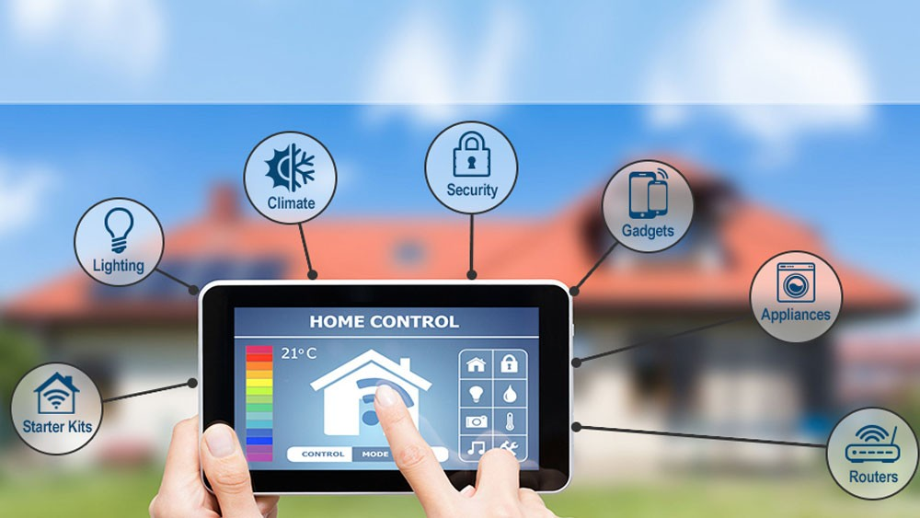
Idea for Iot
Automation
Consider integrating machine learning models to enhance the automation and decision making capabilities of the smart home.

Slide 9

Data Processing
Building the serverless IoT data processing solution using IBM Cloud Functions and device integration.

Slide 10
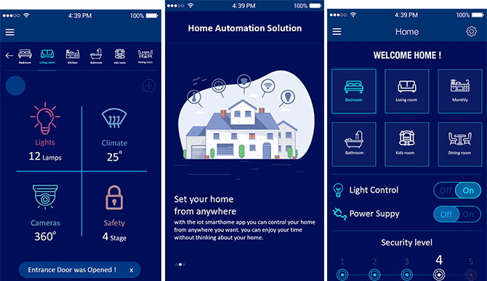
Implemenation
Continue build the solution by implementing real- time data processing, automation, and storage.

Slide 11




Advantages
Cost-Effective
Real-Time Responsiveness Simplified Management Integration Flexibility Energy Efficiency
Global Accessibility Easy Maintenance

Slide 12
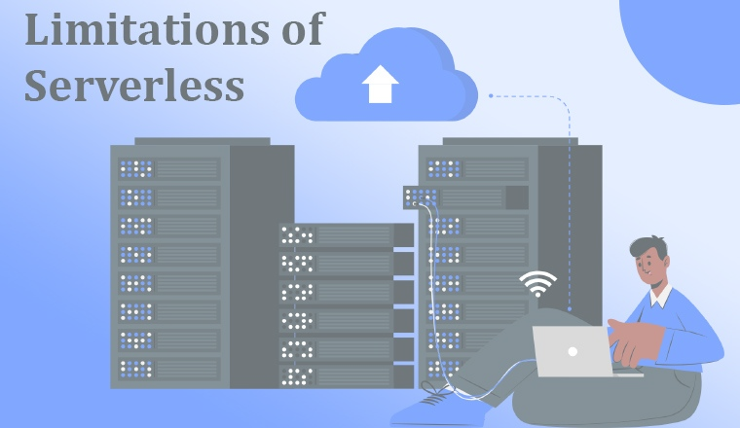
Disadvantages
Limited Control Resource Limitations Data Privacy Concerns Cost Uncertainty Internet Dependency Compatibility Issues

Slide 13
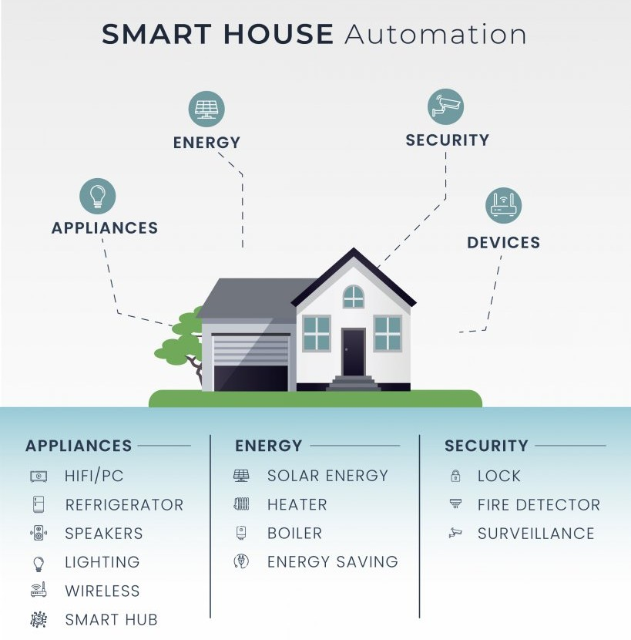
Benifits
Finally the Smart living space is created by using IBM cloud Function for build a Iot data processing
We can oprate the devices in outside of the home so its helps to reduce eletricity charge and some other issuse.

Slide 14
Thank You...

